Slide 1

MACHINE VISION BASED AUTOMATED 3-DoF ARTICULATED ROBOT FOR FRUIT DEFECT IDENTIFICATION AND SEGREGATION
RAJALAKSHMI ENGINEERING COLLEGE (AUTONOMOUS)
DEPARTMENT OF MECHATRONICS ENGINEERING
MT17811 - Project Phase II
Name of The Batch Members and Register Numbers:
Aravind S - 181201004
Ariharan K - 181201005
Venkateshwaran T K - 181201051
Name of The Supervisor : Mr. S. Ramkumar
Designation : Assistant professor
BATCH NO: 01

Slide 2
ABSTRACT
In small scale industries, skilled labor is required for quality inspection where time consumption, fatigue is higher and accuracy is lower.
This project that we propose, is a solution to inspect the product’s quality using deep learning and handling them with an anthropomorphic robot.
This kind of integration can lead to segregating good and bad products using deep learning so that we can expect the removal of defects with greater accuracy.

Slide 3
Objectives
To reduce the human labor in fruit segregation tasks in small scale industries.
To reduce the time consumption in fruit segregation process and thereby increasing the processing speed.
To achieve estimated real-time accuracy while computation.
To promote automation among the growing sectors.

Slide 4
Scope
When improved, area of application and subject to be handled can be varied.
With good imaging sensors, computational capabilities can certainly be improvised.
Can be implemented in a large scale based on the needs.
Advancement in Machine vision to increase the flexibility of the process.
Speed of the process can be improved based on the situation.

Slide 5
Literature Survey
Survey 1: Pick-place of dynamic objects by robot manipulator based on deep learning and easy user interface teaching systems (2017)
Author: Delowar Hossain, Genci Capi, Mitsuru Jindai, Shin-ichiro Kaneko
Inspection through USB and application of DBNN to recognize objects and work on them accordingly.
Uses three different methods of Teaching methods for the DBNN to learn on itself and operate with ease.
Also explains about the accuracy achieved as well as the approach to operate with the robot.
Survey 2: Deep Learning-Based Object Classification and Position Estimation Pipeline for Potential Use in Robotized Pick-and-Place Operations (2020)
Author: Sergey Soltan, Artemiy Oleinikov, M. Fatih Demirci and Almas Shintemirov
The authors present a novel unified framework for object detection and classification using a combination of point cloud processing and deep learning techniques.
The proposed model uses two streams that recognize objects on RGB and depth data separately and combines the two in later stages to classify objects.

Slide 6
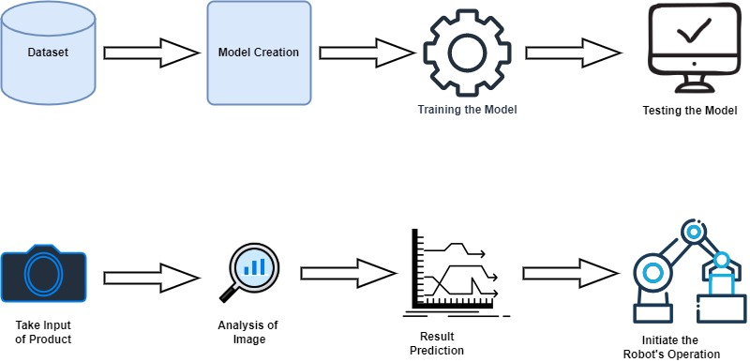
DL Flow Diagram
Training
Testing And Operation

Slide 7
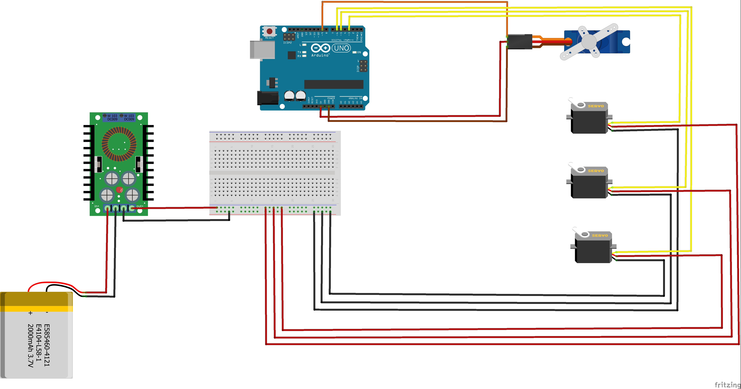
Circuit Diagram

Slide 8
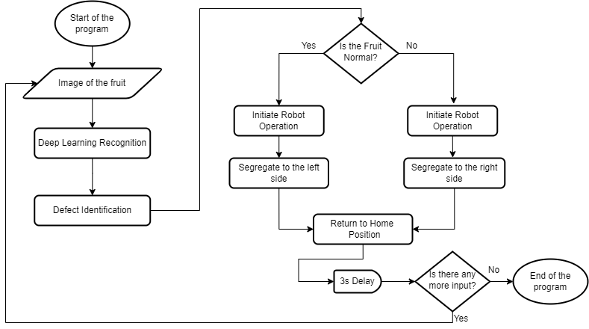
Block Diagram

Slide 9


Pyfirmata Library
pyFirmata is a Python interface for the Firmata protocol.
Firmata is a generic protocol for communicating with microcontrollers from software on a host computer.
It is intended to work with any host computer software package.

Slide 10
Components Used
3-DoF Offset Articulated Robot Kit
Arduino Uno / Nano
Step Down DC-DC XL4015 Converter 5A
12v Li-ion Battery Pack with BMS - 5000mAH
SG 90 Servo Motor - 1
TowerPro MG996R Servo Motor – 3
Camera for Machine Vision
USB A type Cable – For Serial Communication
Breadboard and Jumper Wires
Bush – 6
Base Board and Wooden Block
Fasteners - Screws and Nuts
Computer/Laptop

Slide 11
Working Code – Main File.py
import os
os.chdir("REC\Projects\Final Year Project\Phase 2\Python code")
from Deep_Learning_Testing import *
from Robot_Code_1 import *
import time
normal_count = 10
Defective_count = 10
while True:
result = start()
if result == 'Normal Lemon’:
normal_count-=1
input_robot('Normal Lemon')
time.sleep(3)
elif result == 'Defective Lemon’:
defective_count-=1
input_robot('Defective Lemon')
time.sleep(3)
print(“---Operation Done---”)

Slide 12
Challenges faced & Discussions
Challenge | Solution
Location for Lemons to be effectively picked by Robot’s end effector | Used a Door stopper Bush to place the lemons
Camera positioning and Mounting | Used PVC Pipes and elbows and screwed the camera to a dummy cap
Two sided Robot Operation | Made Robot’s mean position as an average between two ends of the range
Lighting and Deep Learning Challenges | Resolved by Zooming in by using a line of code and good trained model file

Slide 13
Deviations & Discussions
Before | After
Operation targeted towards rejection of defective fruit | Operation targeted towards segregation of fruits into Normal or Defective Fruit on two sides
Left Mounted Robot | Center Mounted Robot
Video frame capture continuously causes distractions while live operations | Video frames are frozen after 10 frames and result is fetched and Robot is operated
Robot Operation was not crisp due to faulty servo horn and servo cant be controlled effectively | Replaced the servo mounts and Robot operation is controlled properly with very minimal deviation

Slide 14
Stages - Results
Assembly: Components have been attached as per the requirement
Integration: A link between Deep Learning and Arduino is established using pyFirmata
Operation: Robot is operated based on the condition specified from DL Result value
Testing & Results: Real time simulation and testing is carried out successfully based on Normal or Defective Fruit.

Slide 15
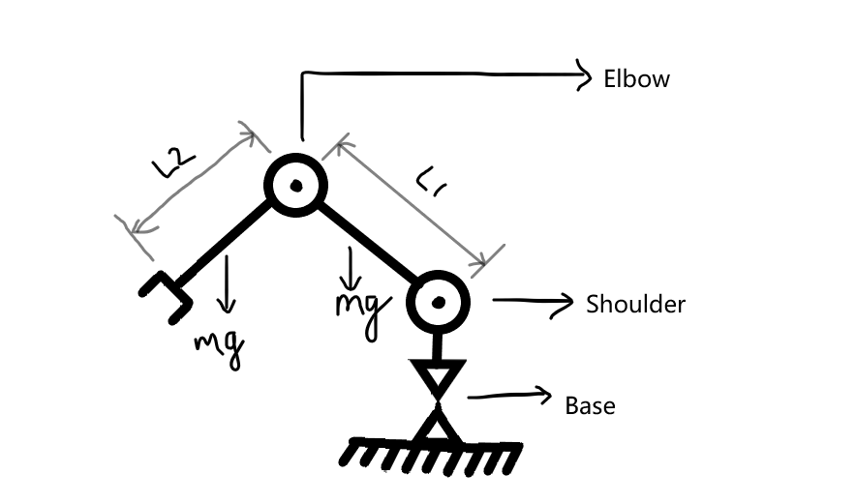
Calculations
Type | Articulated
Degrees Of Freedom | 3
Configuration | RRR
Maximum Reach | 400mm approx.
Maximum Payload | 40 grams
Maximum height | 250 mm

Slide 16
Calculations
Torque Calculations
T = F × sinθ × r
W.K.T => F = m × g T = m × g × sinθ × r
Torque developed at Joint 1: T₁= F𝑙𝑜𝑎𝑑 × (L1+L2) + W2 × L2 /2 + L1 + W3 × 𝐿1 + 𝑊1×L1 /2
Torque developed at Joint 2: T2= F𝑙𝑜𝑎𝑑 × L2 + W₂ × L₂ / 2
By Calculating based on the above given formulas, let us consider 200g payload at maximum
we obtain approximate torque value of
T1 = 0.9 N-m = 90 N – cm = 9 kgf – cm (max. torque of servo = 10 kgf-cm)
T2 = 0.3 N-m = 30 N – cm = 3 kgf – cm

Slide 17
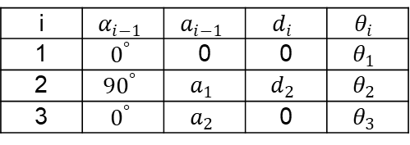
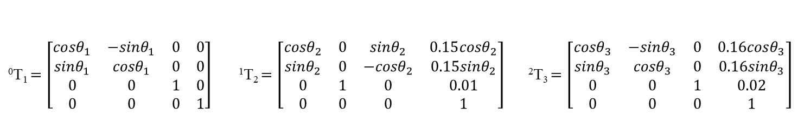
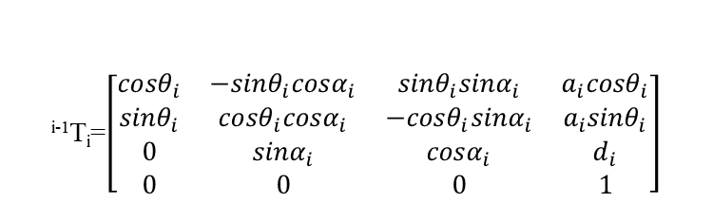
Calculations
DH Parameters
i | $$α_{i−1}$$ | $$a_{i−1}$$ | $$d_{i}$$ | $$θ_{i}$$
1 | $$0^{°}$$ | 0 | 0 | $$θ_{1}$$
2 | $${90}^{°}$$ | $$a_{1}$$ | $$d_{2}$$ | $$θ_{2}$$
3 | $$0^{°}$$ | $$a_{2}$$ | 0 | $$θ_{3}$$
^{i-1}T_{i}=$\left[\begin{matrix}{cosθ}_{i} & {−sinθ}_{i}{cosα}_{i} & {sinθ}_{i}{sinα}_{i} & a_{i}{cosθ}_{i} \\ {sinθ}_{i} & {cosθ}_{i}{cosα}_{i} & {−cosθ}_{i}{sinα}_{i} & a_{i}{sinθ}_{i} \\ 0 & {sinα}_{i} & {cosα}_{i} & d_{i} \\ 0 & 0 & 0 & 1\end{matrix}\right]$
⁰T₁$=\left[\begin{matrix}{cosθ}_{1} & {−sinθ}_{1} & 0 & 0 \\ {sinθ}_{1} & {cosθ}_{1} & 0 & 0 \\ 0 & 0 & 1 & 0 \\ 0 & 0 & 0 & 1\end{matrix}\right]$ ¹T₂$=\left[\begin{matrix}{cosθ}_{2} & 0 & {sinθ}_{2} & 0.15{cosθ}_{2} \\ {sinθ}_{2} & 0 & −{cosθ}_{2} & 0.15{sinθ}_{2} \\ 0 & 1 & 0 & 0.01 \\ 0 & 0 & 0 & 1\end{matrix}\right]$ ²T₃$=\left[\begin{matrix}{cosθ}_{3} & {−sinθ}_{3} & 0 & 0.16{cosθ}_{3} \\ {sinθ}_{3} & {cosθ}_{3} & 0 & 0.16{sinθ}_{3} \\ 0 & 0 & 1 & 0.02 \\ 0 & 0 & 0 & 1\end{matrix}\right]$

Slide 18
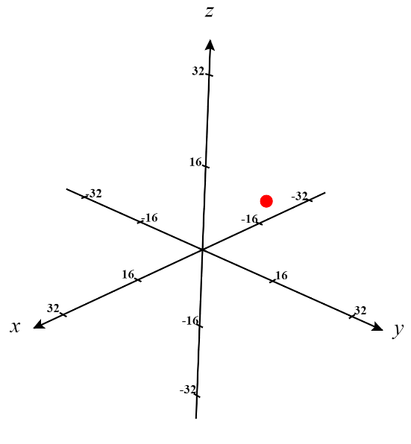
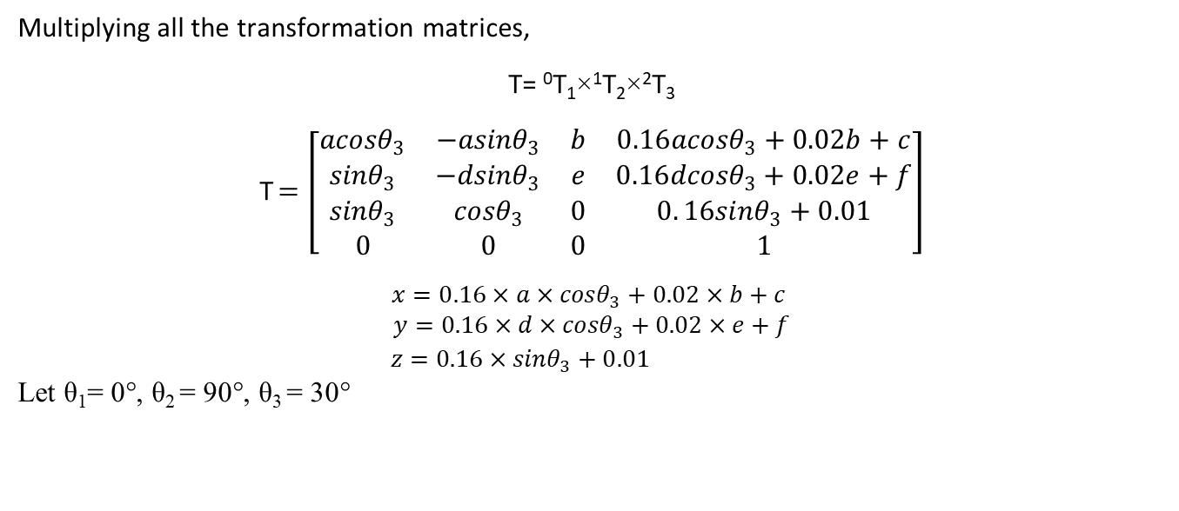

Calculations
Multiplying all the transformation matrices,
T= ⁰T₁×¹T₂×²T₃
T$=\left[\begin{matrix}{acosθ}_{3} & {−asinθ}_{3} & b & 0.16{acosθ}_{3}+0.02b+c \\ {sinθ}_{3} & {−dsinθ}_{3} & e & 0.16{dcosθ}_{3}+0.02e+f \\ {sinθ}_{3} & {cosθ}_{3} & 0 & 0.{16sinθ}_{3}+0.01 \\ 0 & 0 & 0 & 1\end{matrix}\right]$
$$x=0.16×{a×cosθ}_{3}+0.02×b+c$$
$$y=0.16×d×{cosθ}_{3}+0.02×e+f$$
$z=0.16×{sinθ}_{3}+0.01$
Let θ₁= 0°, θ₂ = 90°, θ₃ = 30°
$$x=2cm y=15cm z=15cm$$

Slide 19
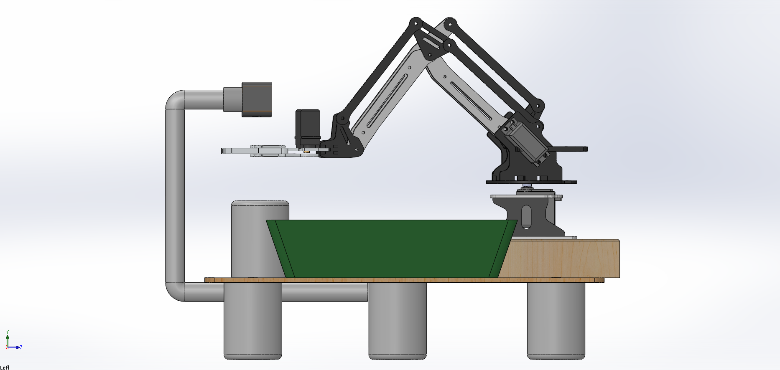
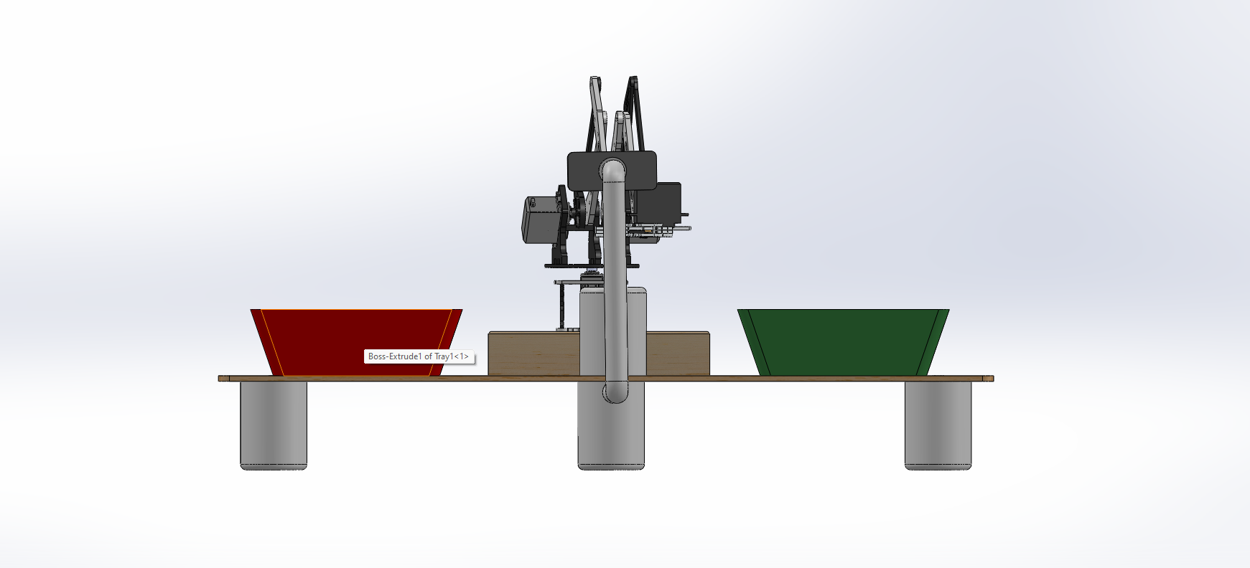
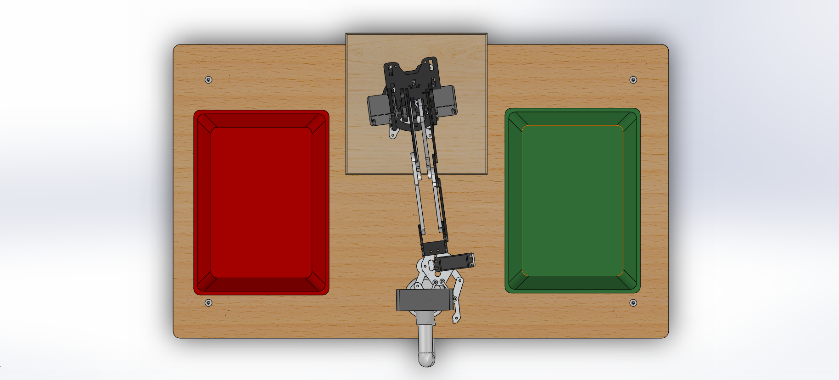
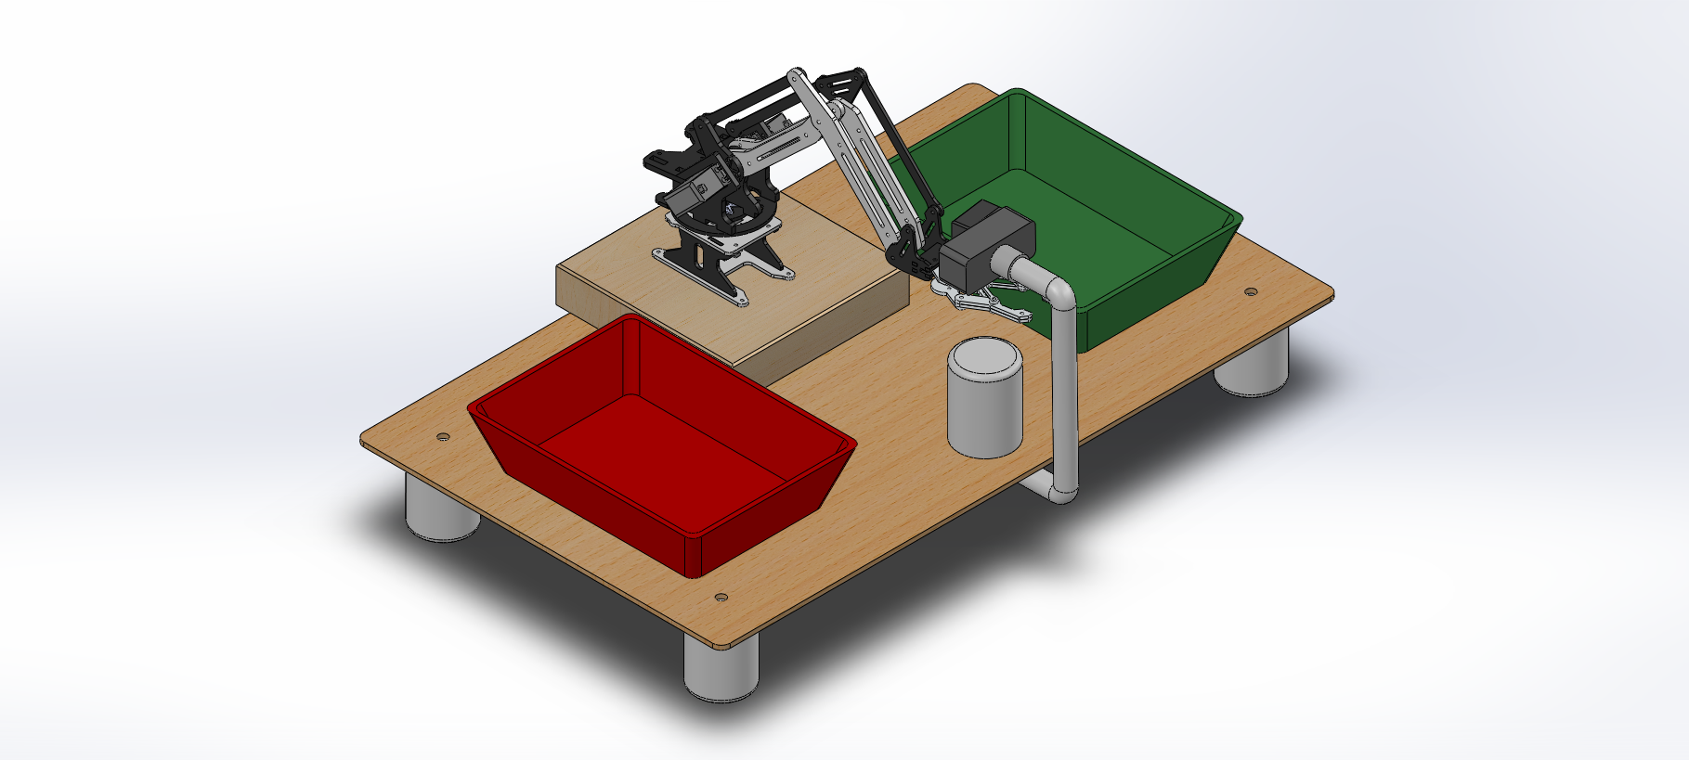
Assembly Views for Reference
Front View
Side View
Top View
Isometric View

Slide 20
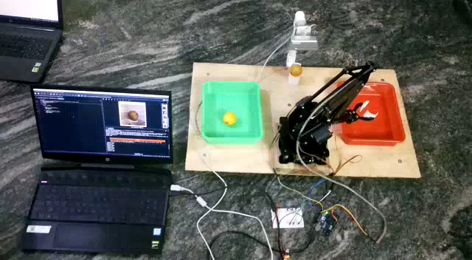
Results – Working Video

Slide 21
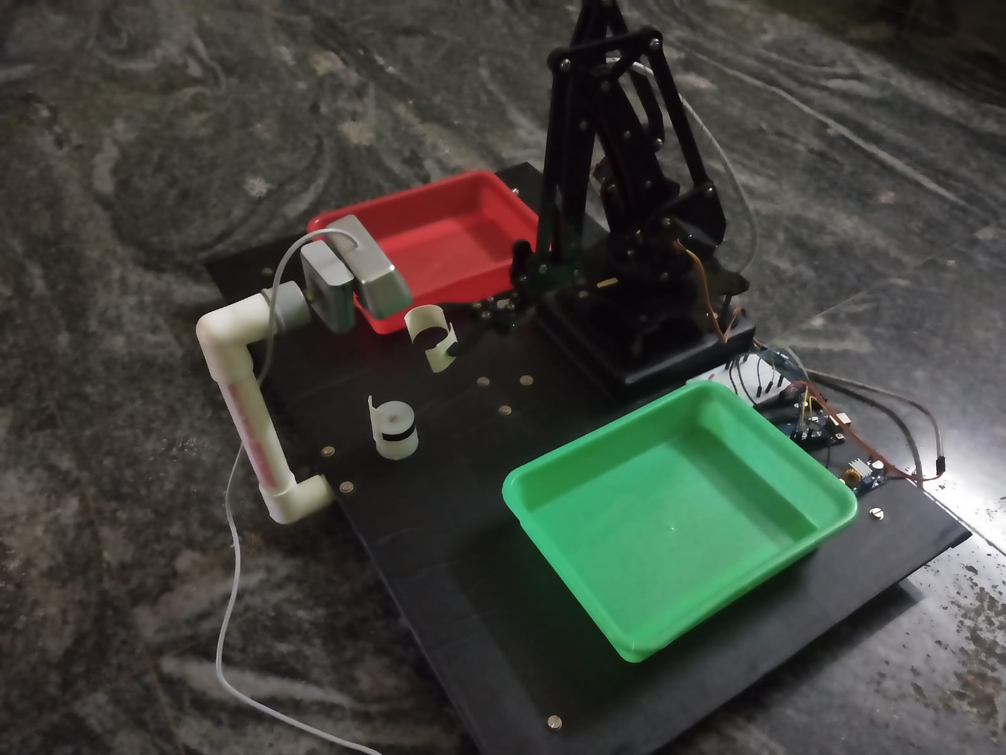
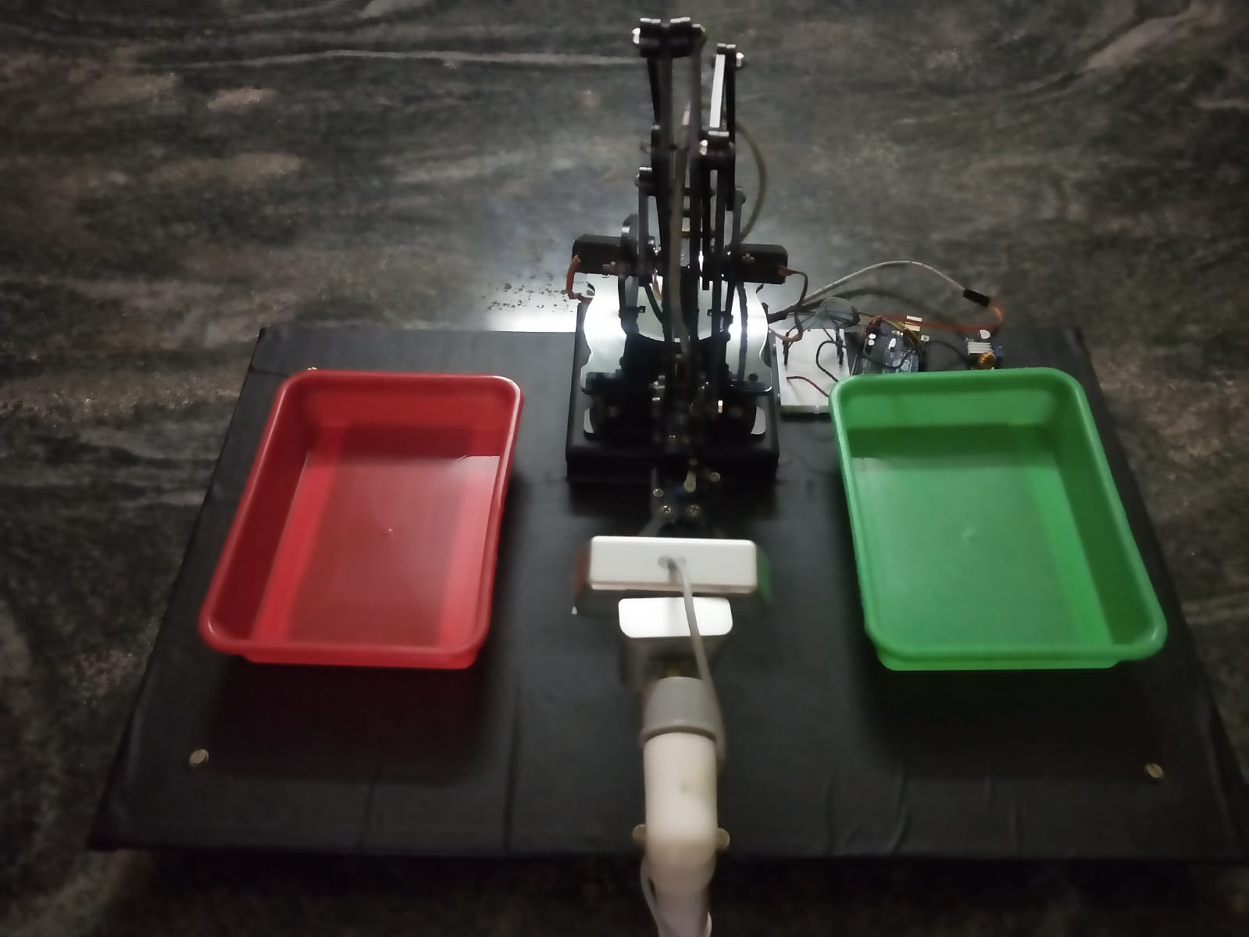
Results – Setup Images during testing

Slide 22
Results & Conclusion
We have managed to identify whether the lemon is normal or defective.
We were able to perform the robot operation based on the input obtained from the identification using deep learning algorithm.
Segregation was performed successfully for both normal and defective lemons.
From the operation, the time taken is as follows:
Total Cycle Time | 40 seconds
Time Taken for Normal Lemon Segregation | 17 seconds approx.
Time taken for Defective Lemon Segregation | 17 seconds approx.

Slide 23
References
Machine vision based fruit classification and grading (July 2017), Sapan Naik, Bankim Patel
Quality recognition of banana images using classifiers (January 2020), Dr.A.Anushya
Review for the current performances for machine visions in industrial robotic welding and drilling tasks (May 2020), Hamza Alzarok, Simon Fletcher, Naeem S.Mian
Modeling and Development of a five DoF vision based remote operated robotic arm (November 2019), Shahriar Rahman Fahim, Md Rashiduzzaman, Sanjay Dey, Md Sakhawat Hosen

